Slide 1

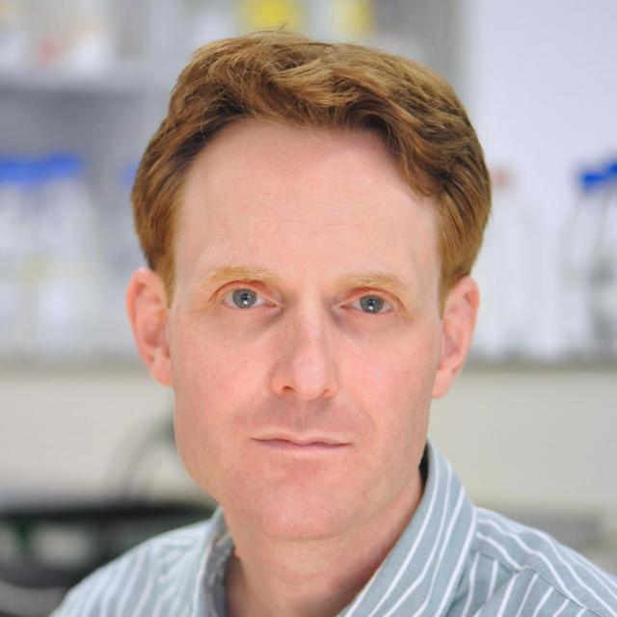
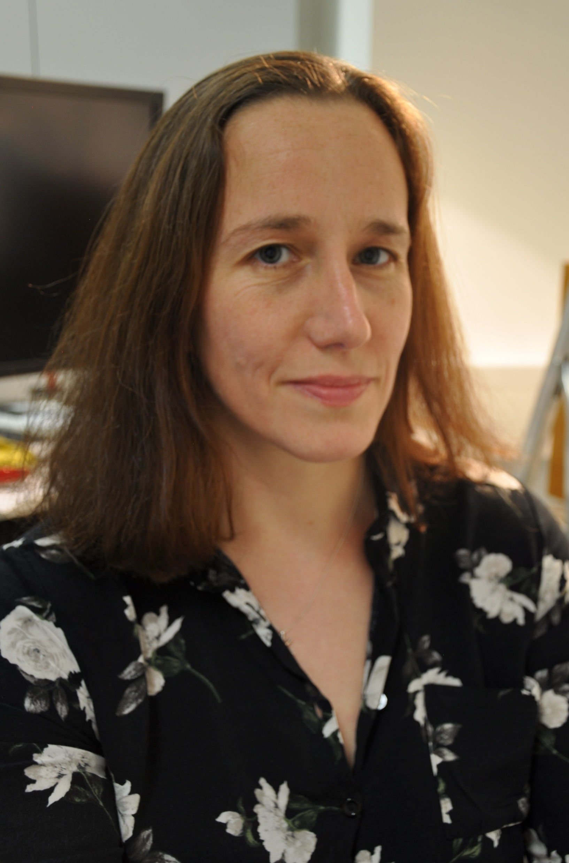
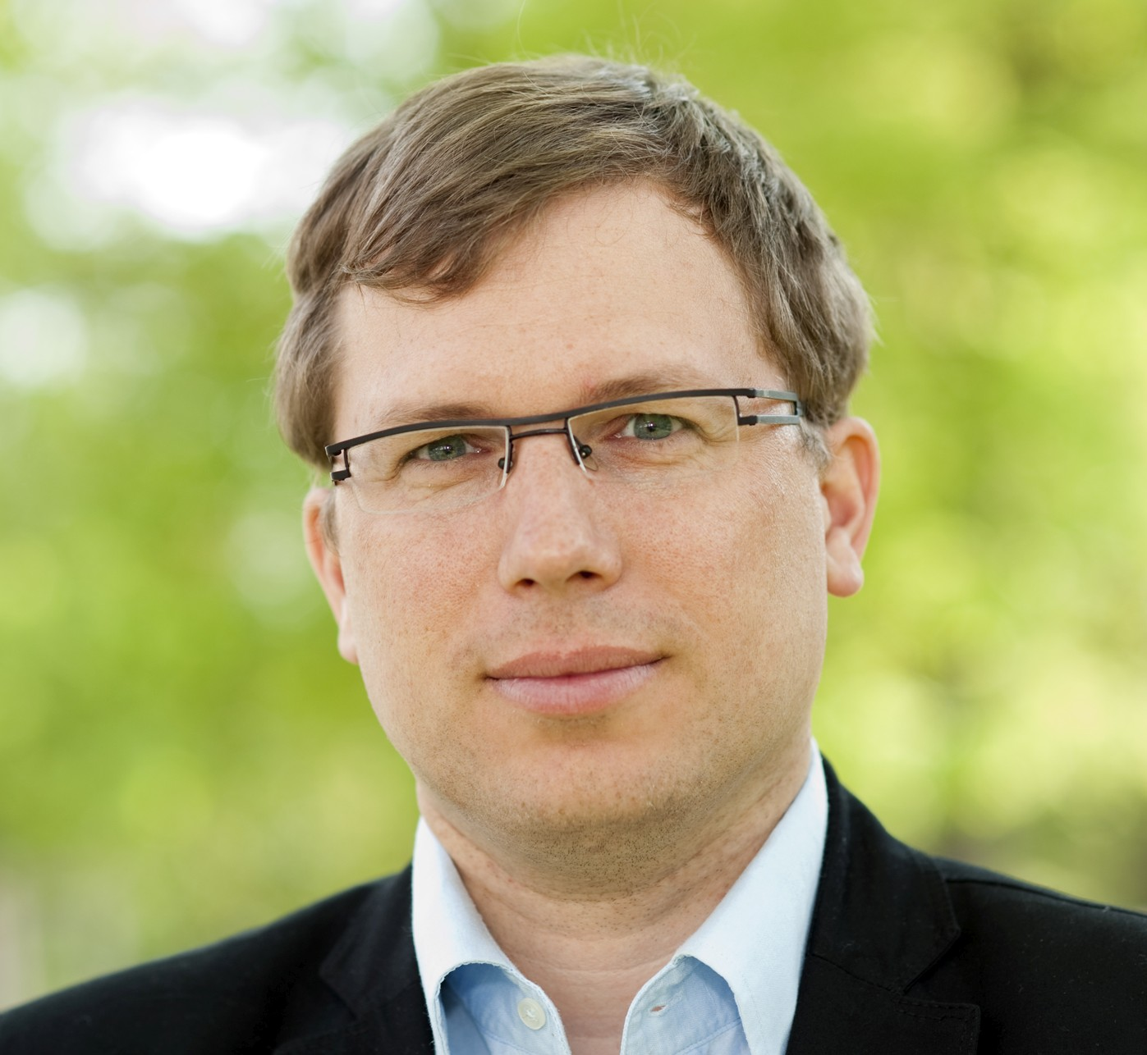
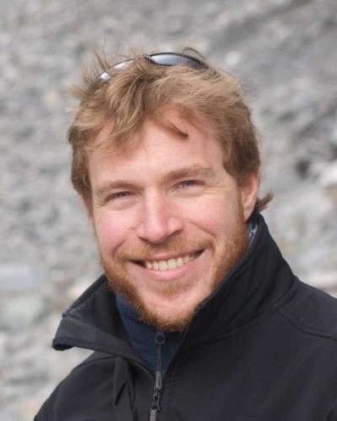
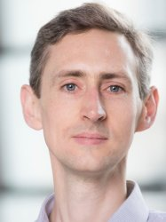
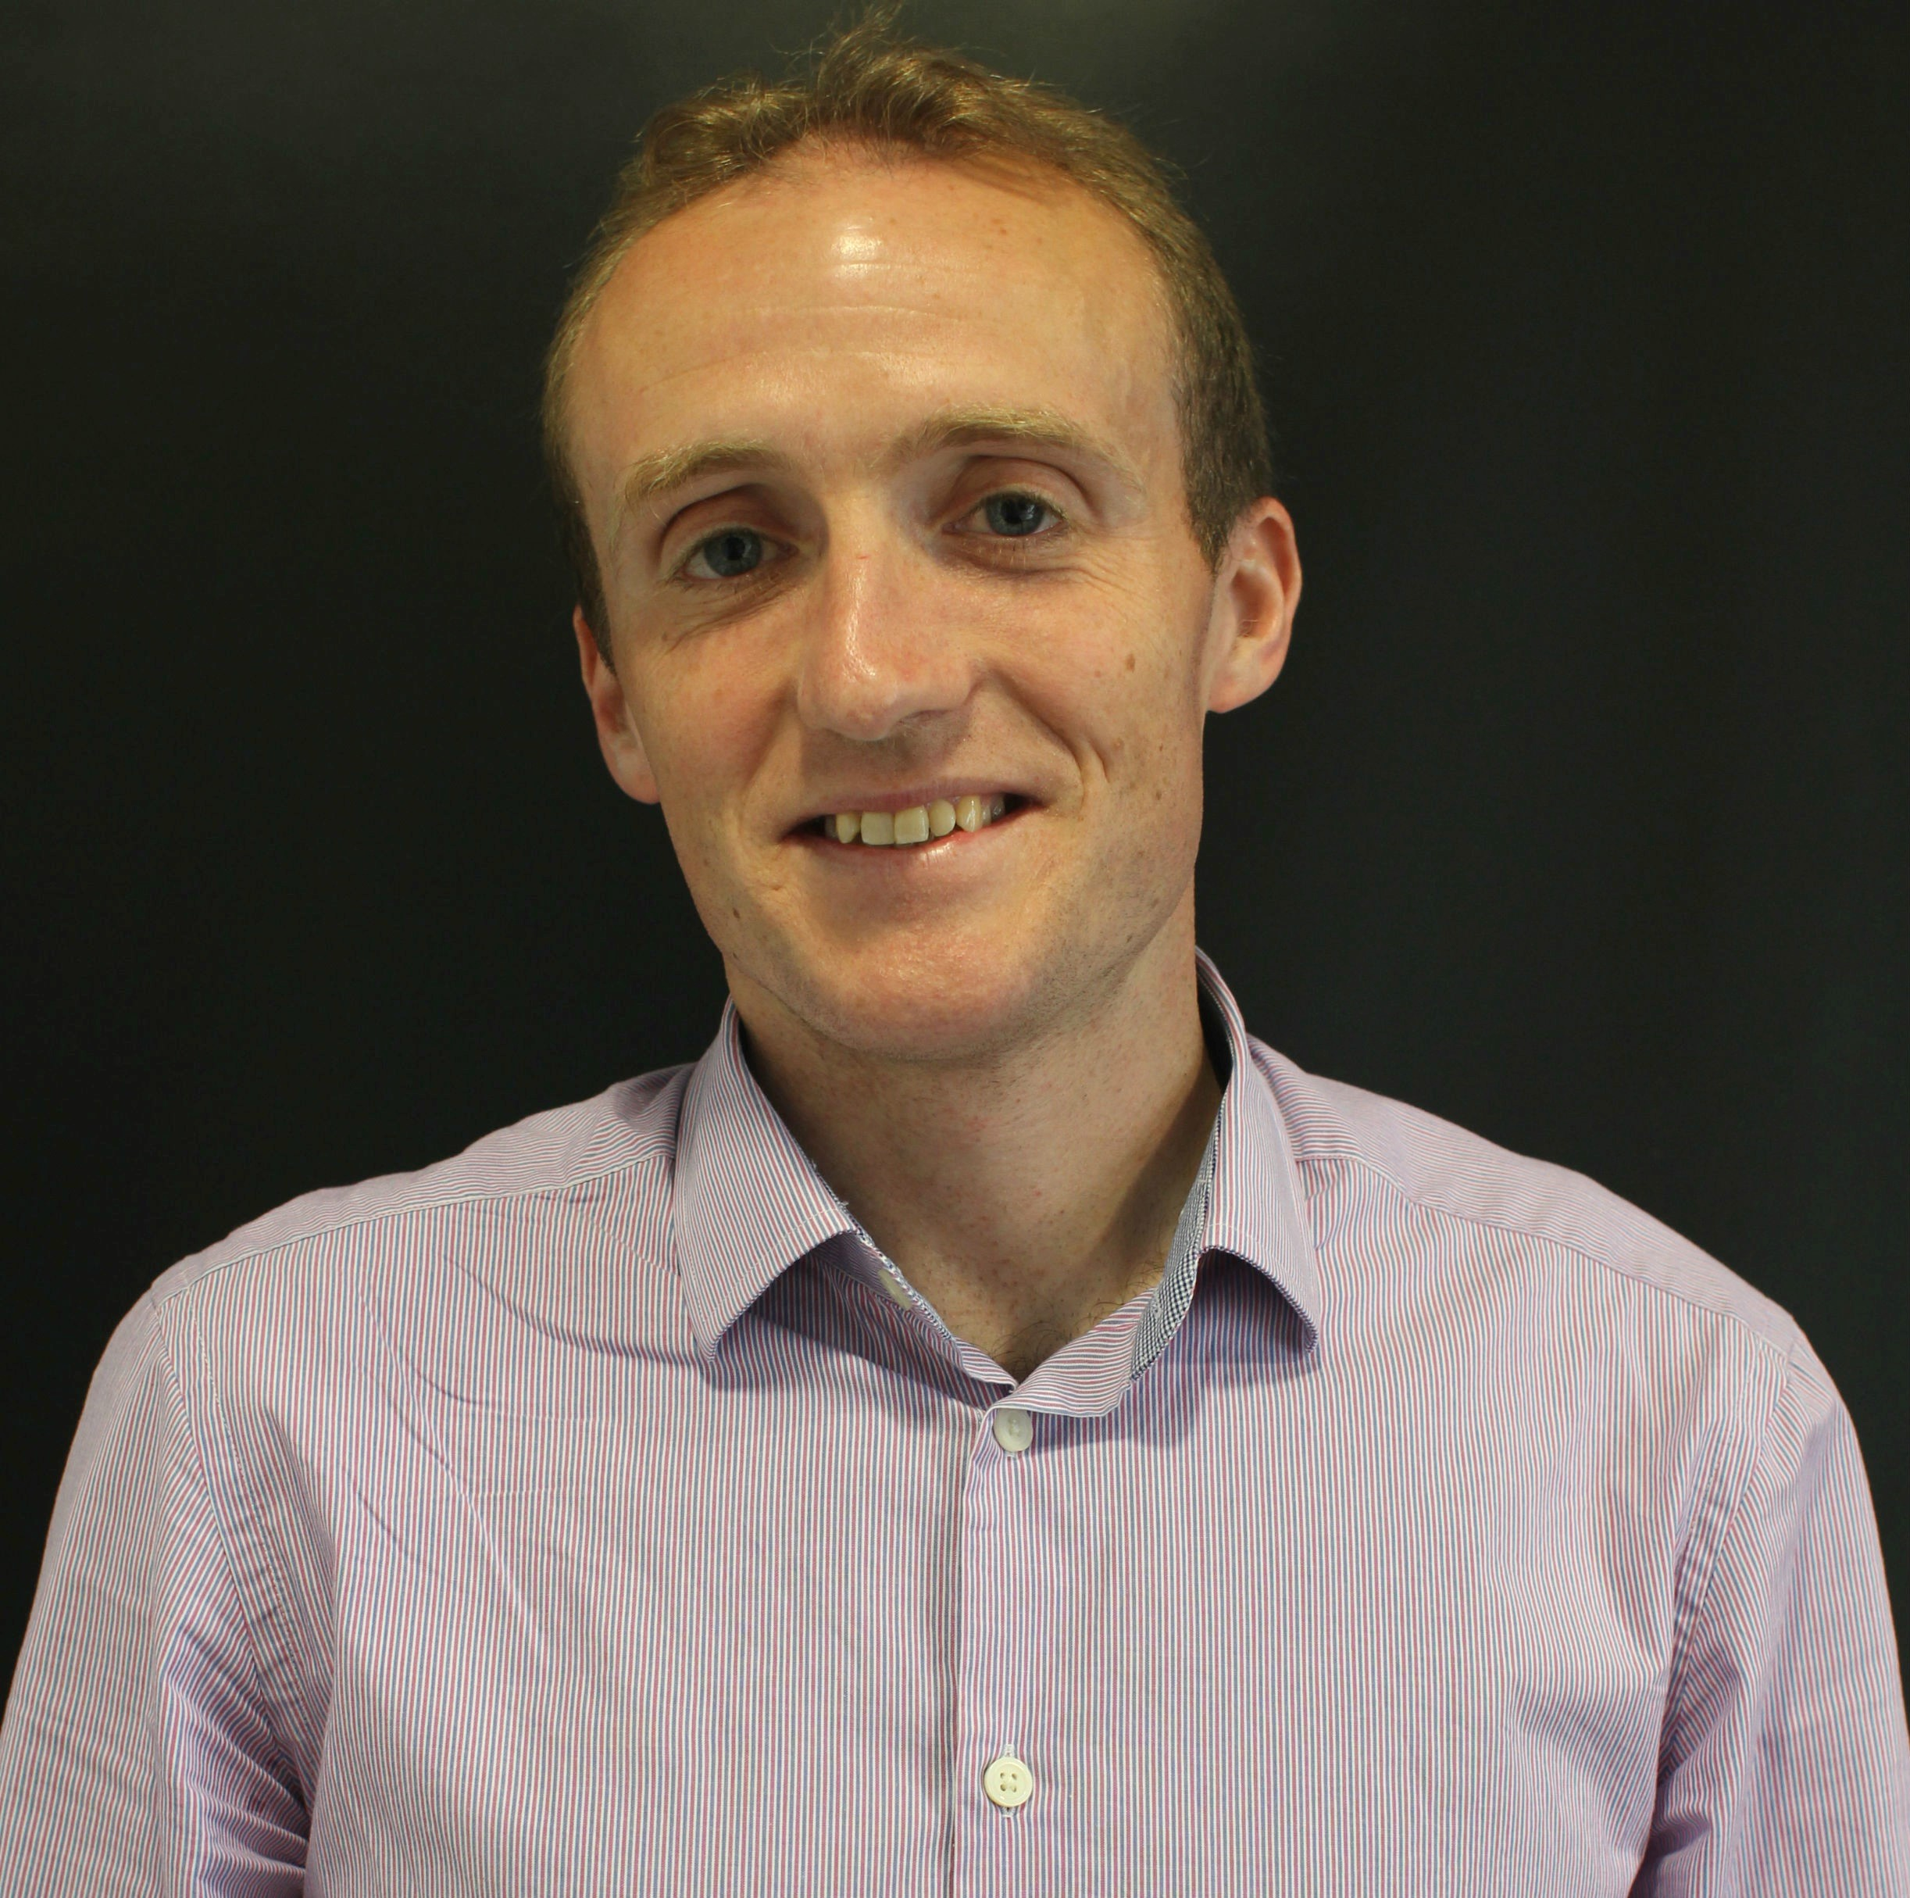
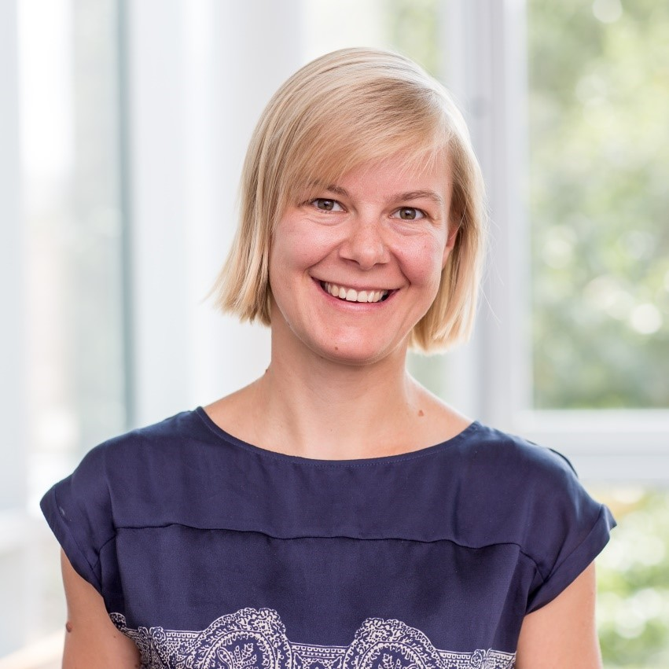
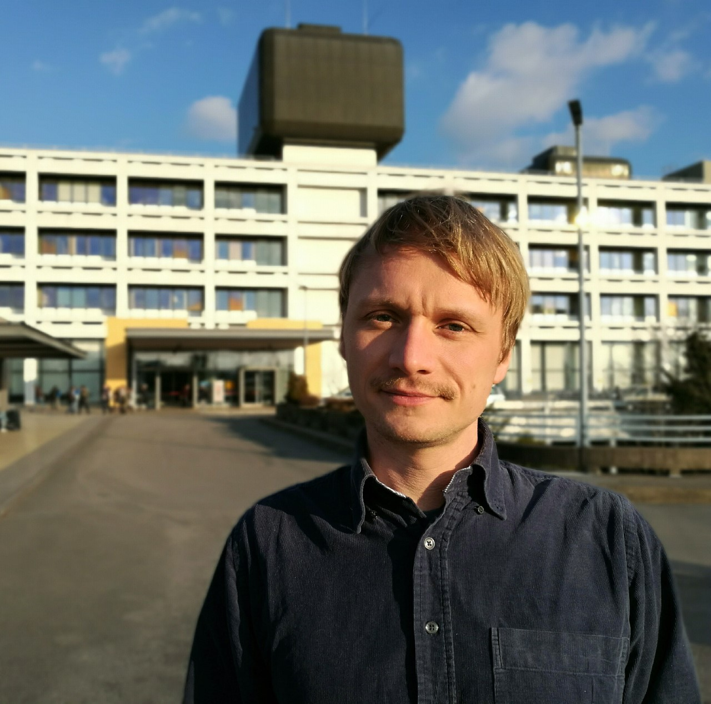
TBC
Daniël Pijnapple
Hart Long
Leonardo Sacconi
LENS
Gail McConnell
Strathclyde University
Philipp Sasse
University of Bonn
Alex Corbett
University of Exeter
Martin Bishop
King’s College London
TBC
Franziska Schneider-Warme
Herzzentrum Freiburg
Chris Dunsby
Imperial College
Jan Christoph
University Medical Centre Göttingen
Selected from abstracts

Slide 2
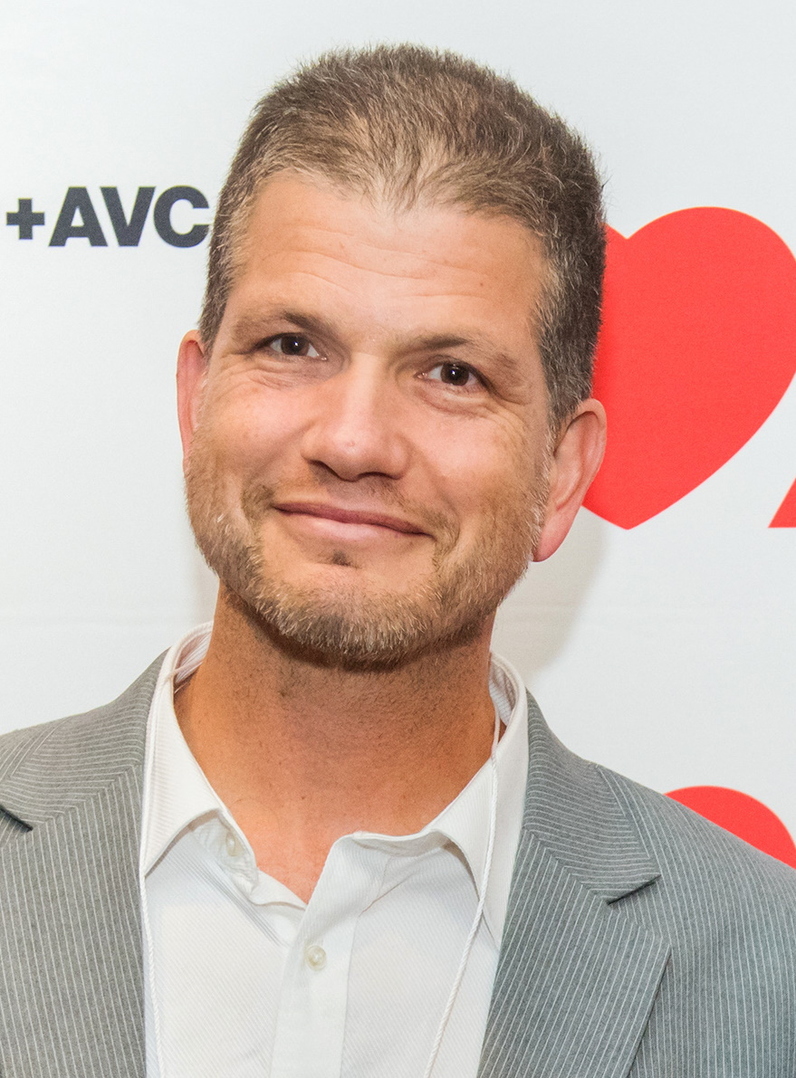
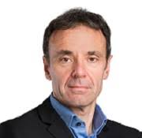
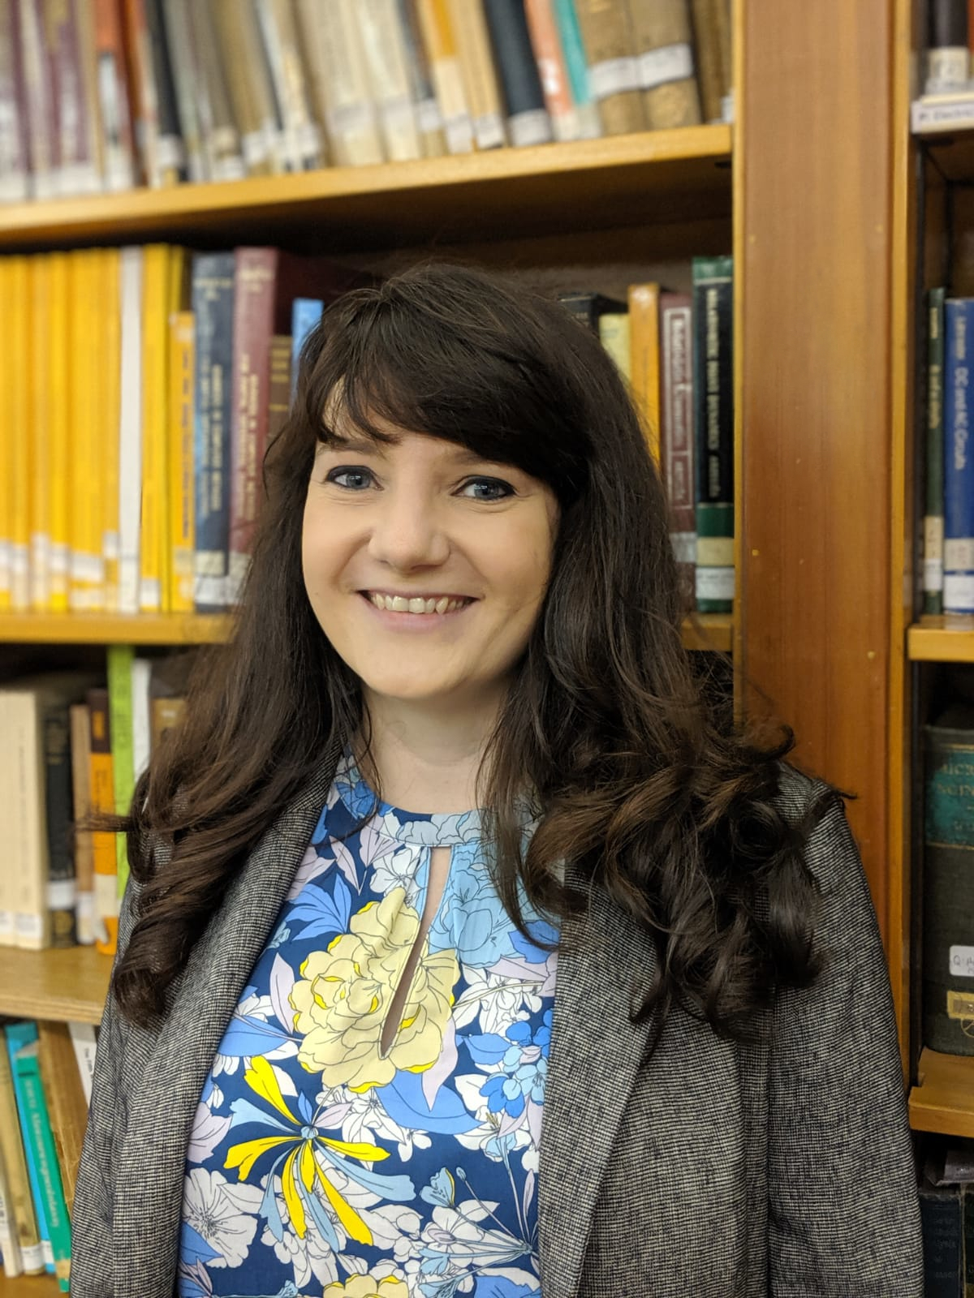
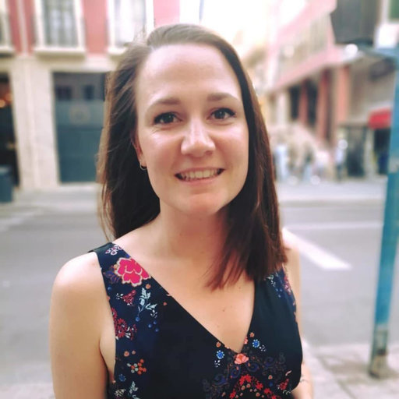
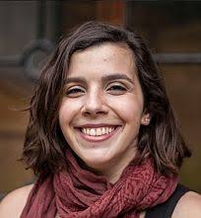
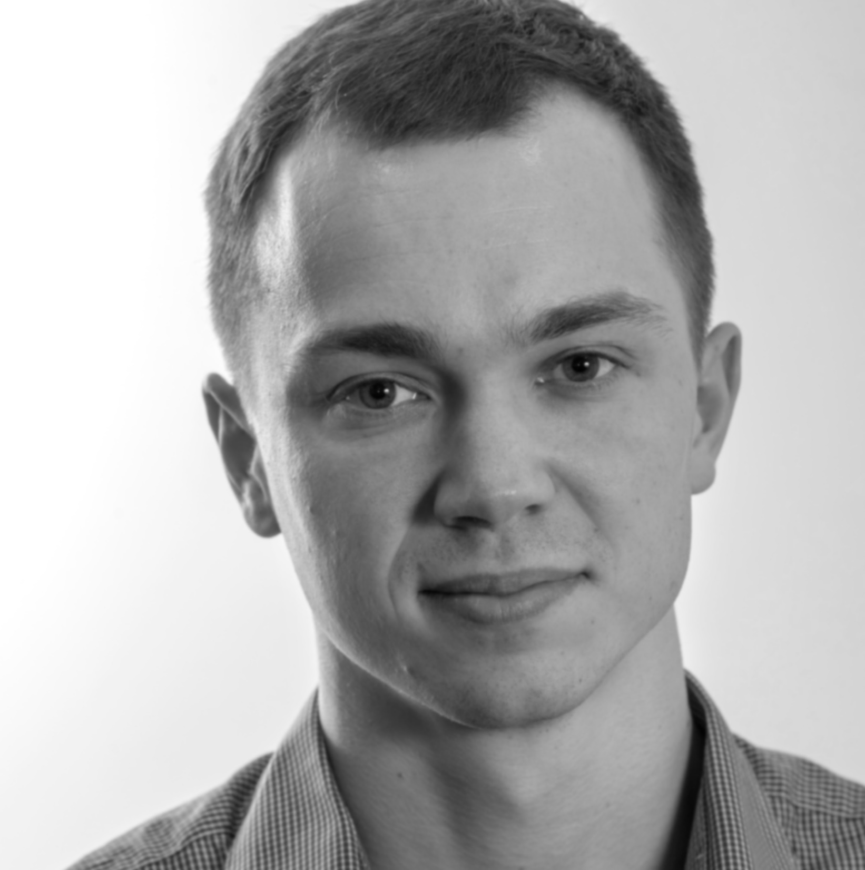
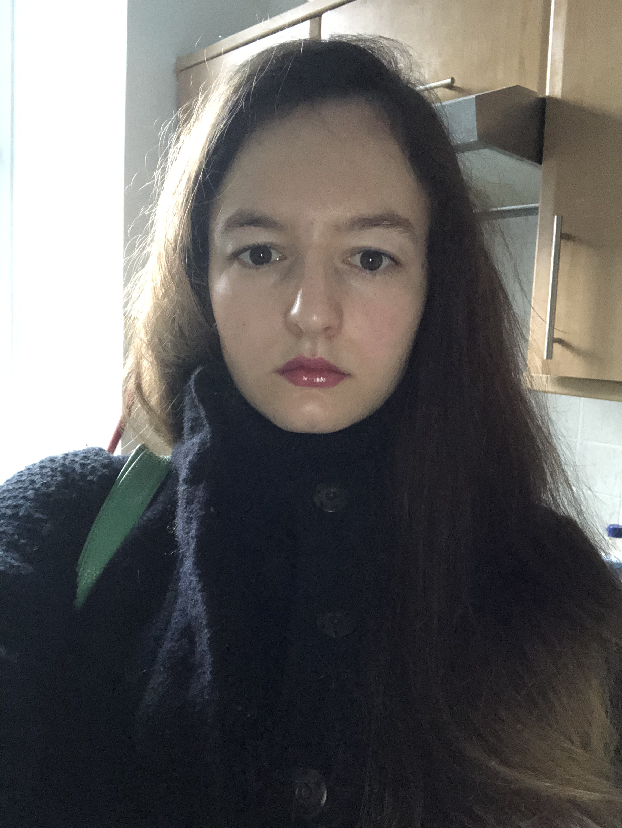
Leonardo Sacconi
Gil Bub
Godfrey Smith
Caroline Müllenbroich
Caroline Müllenbroich
Godfrey Smith
Eline Huethorst
Ana Costa
Vytautas Zickus
Lucrezia Cester

